Slide 1

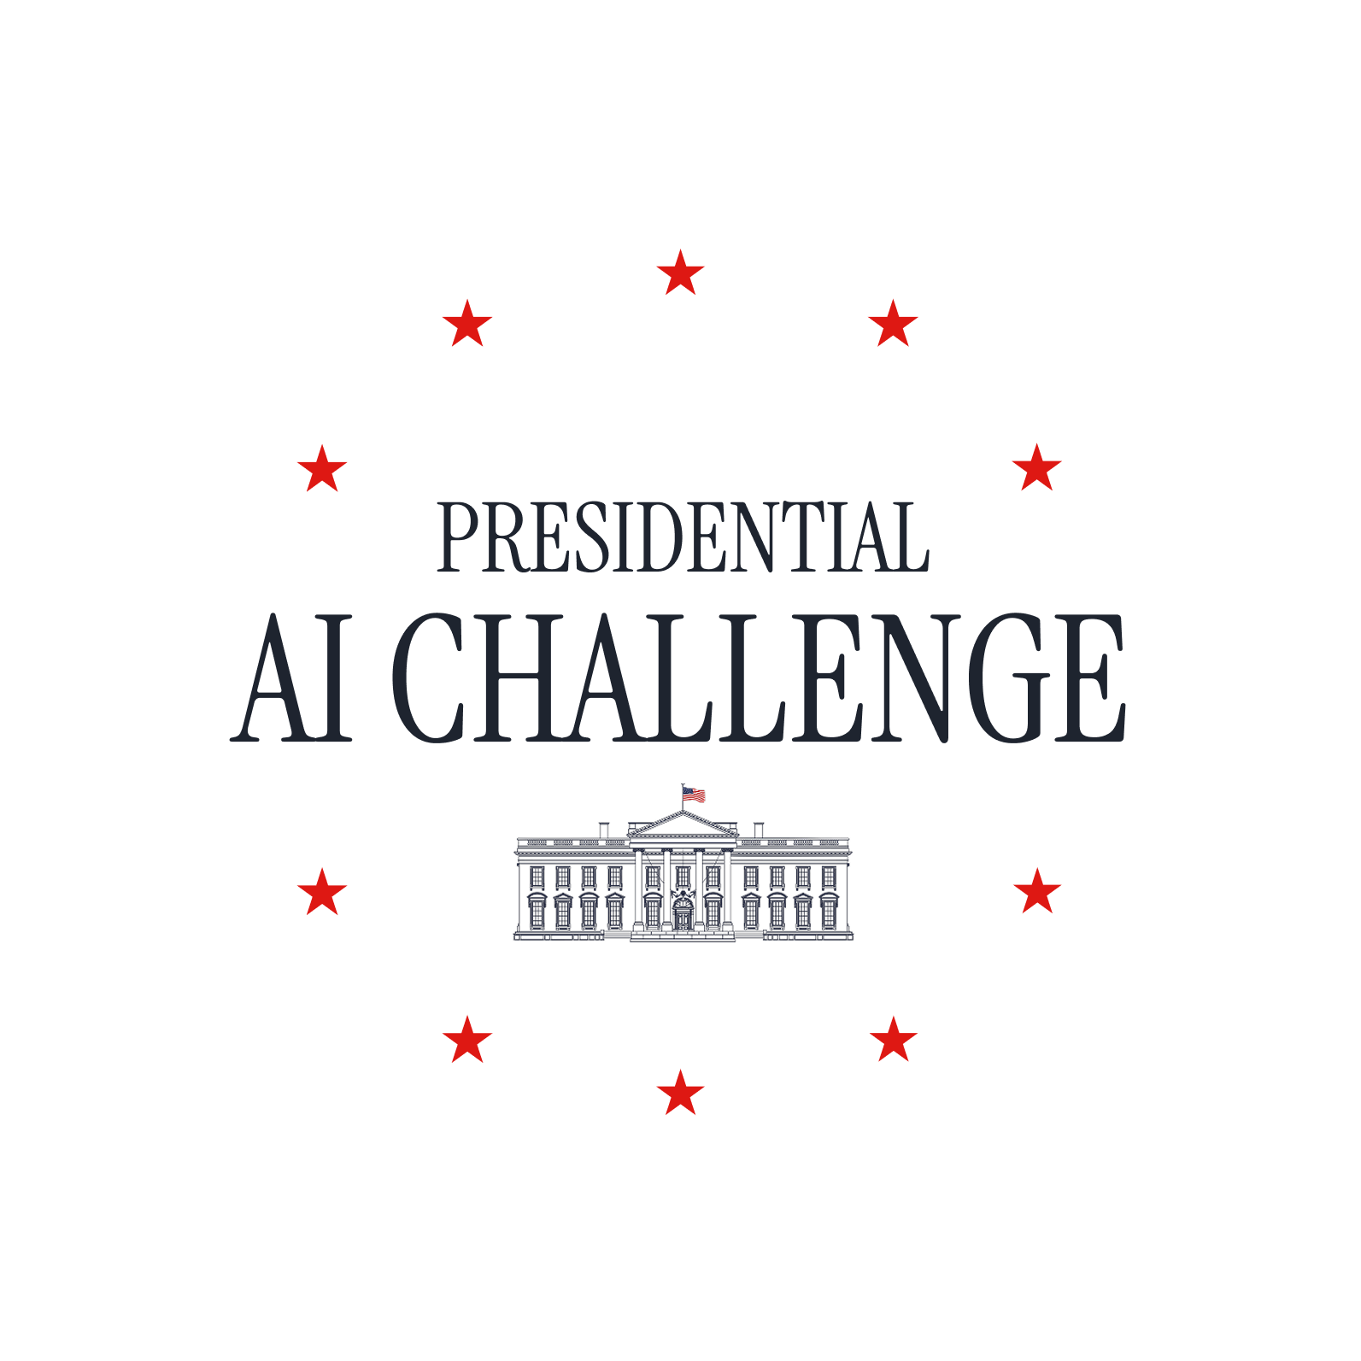
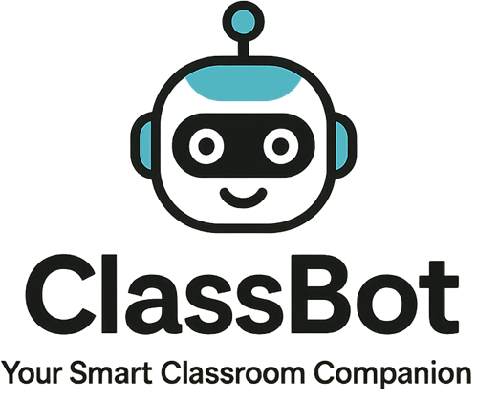
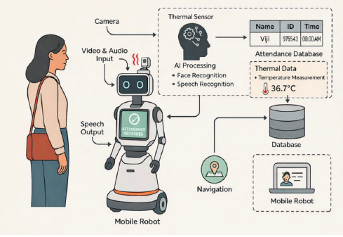
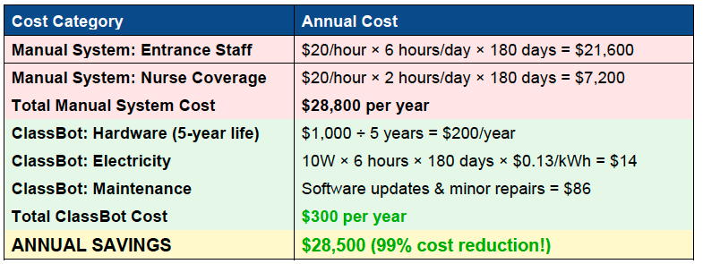
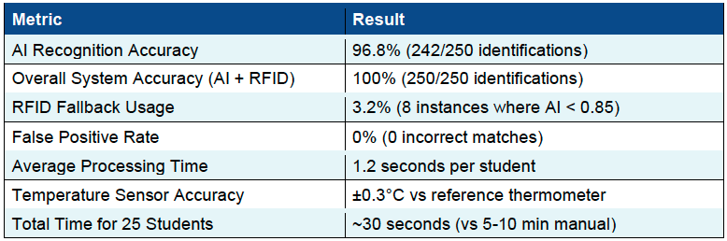
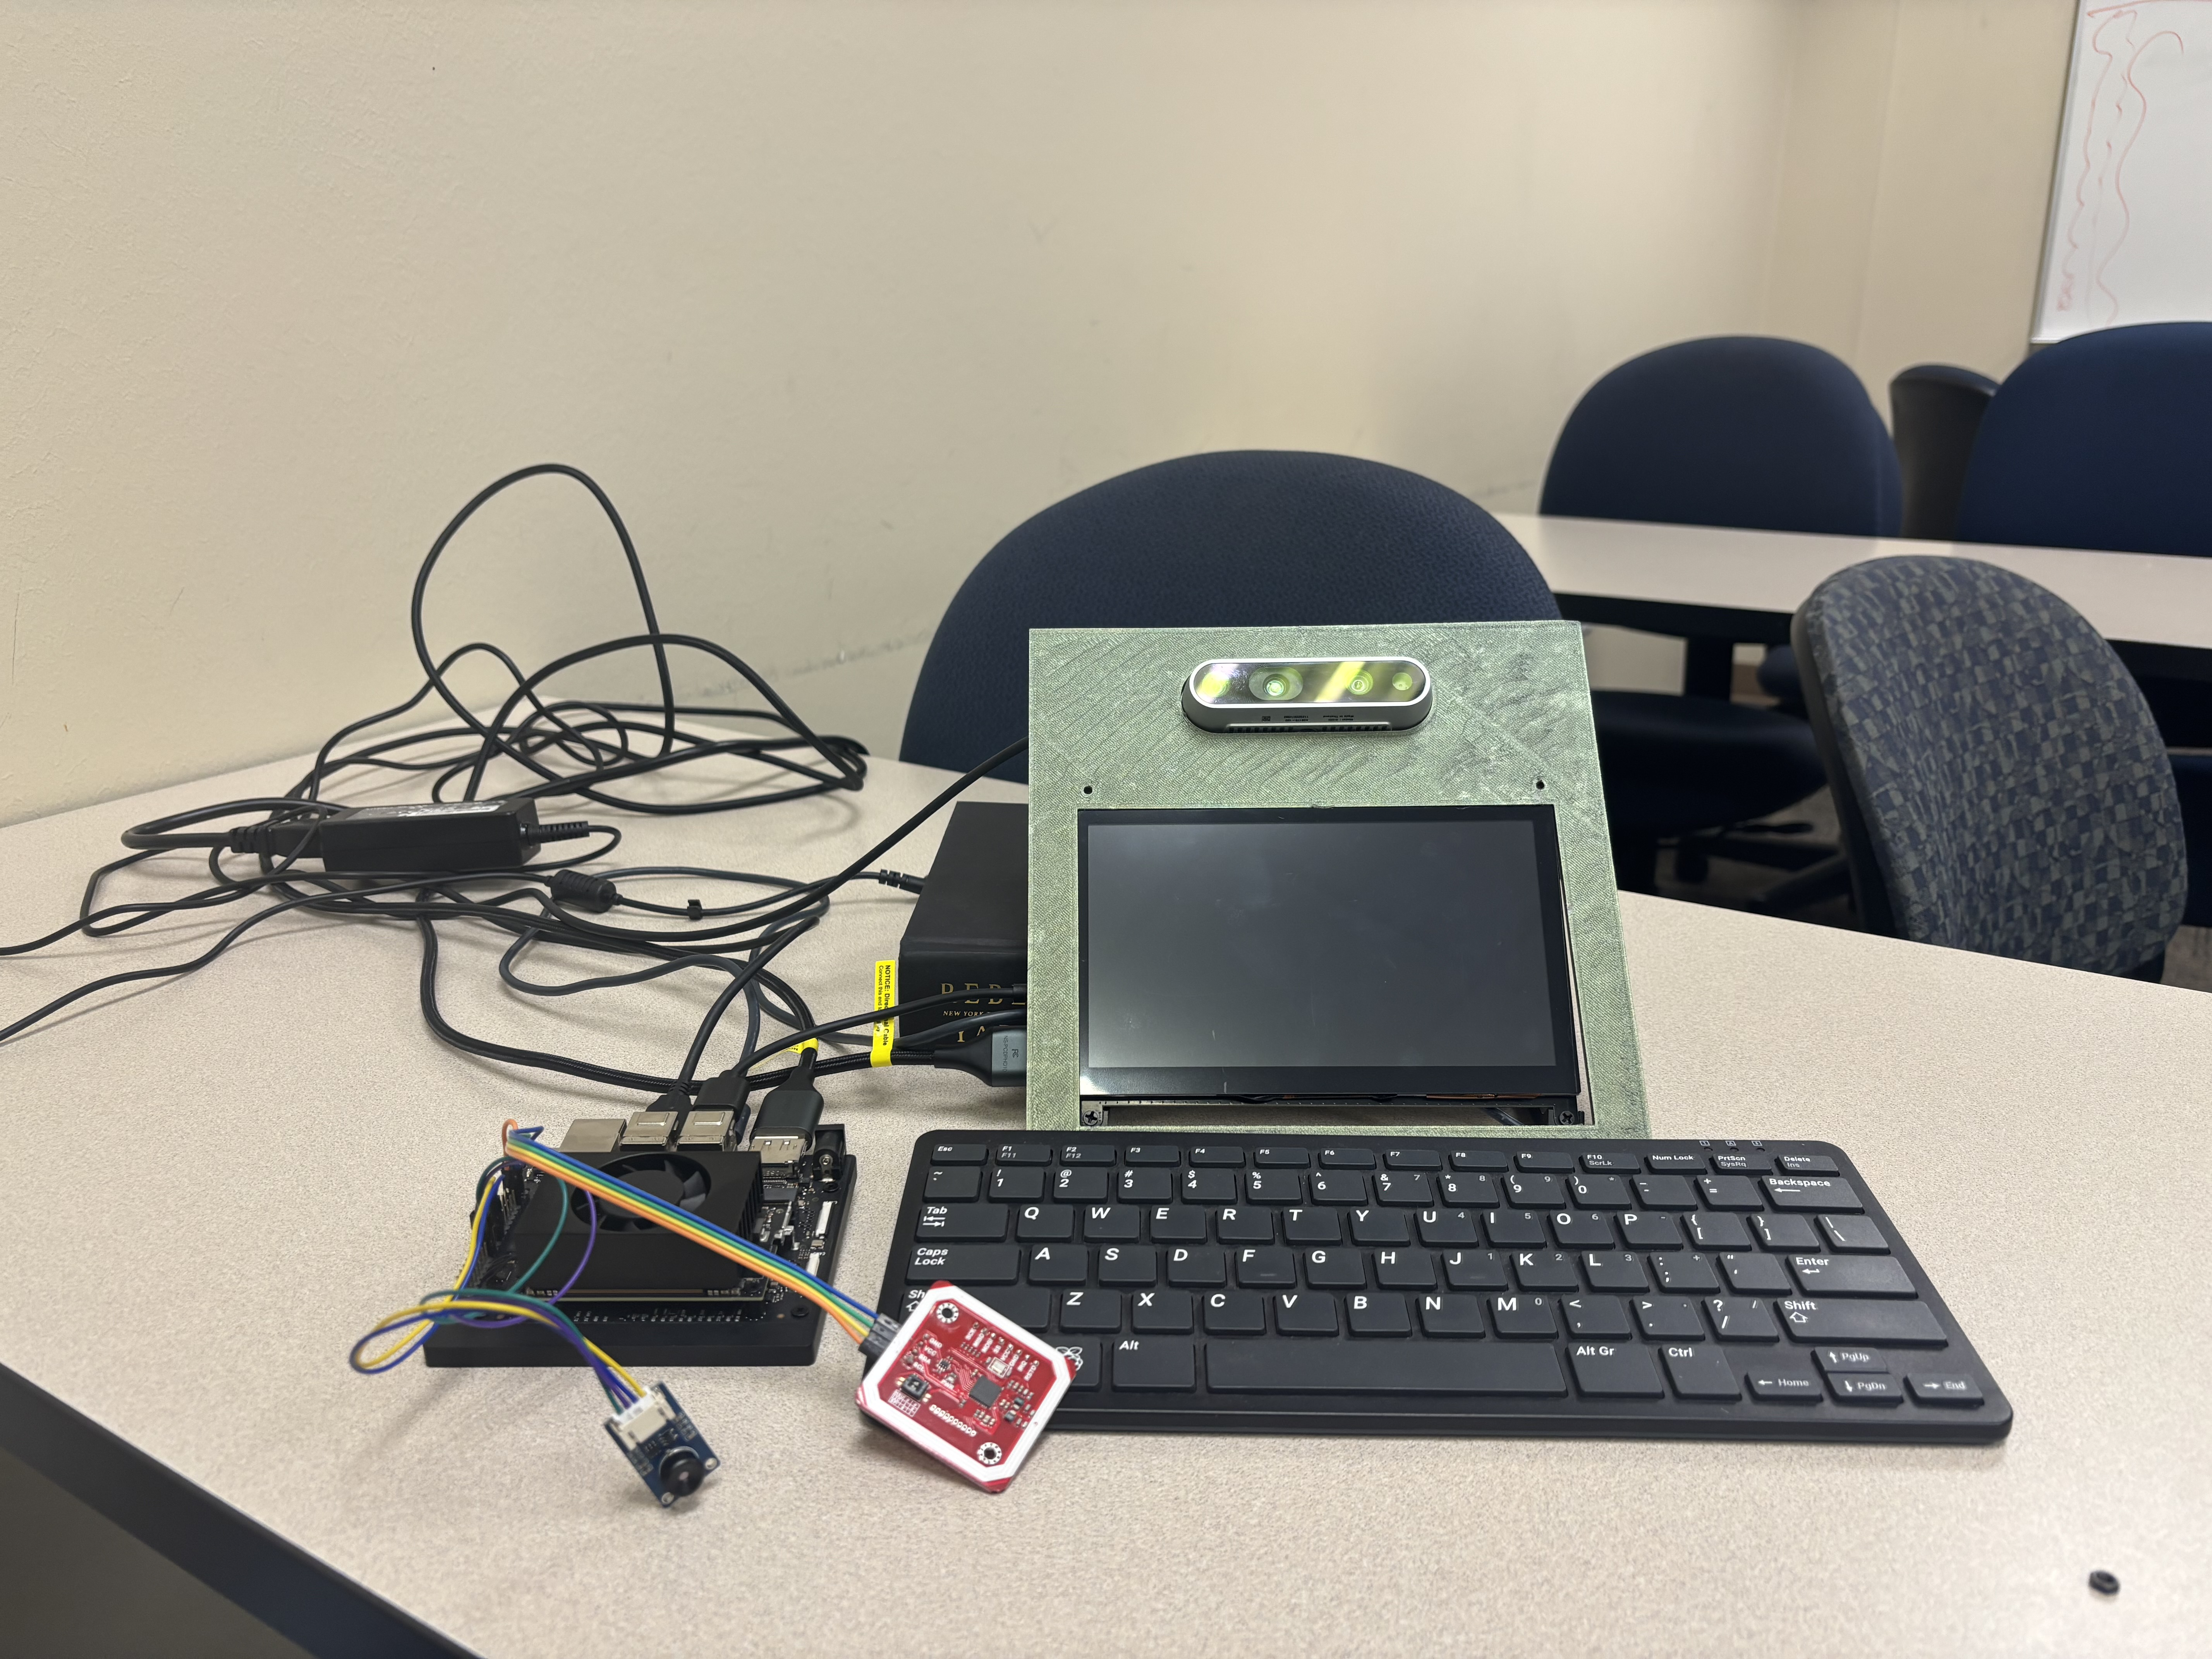
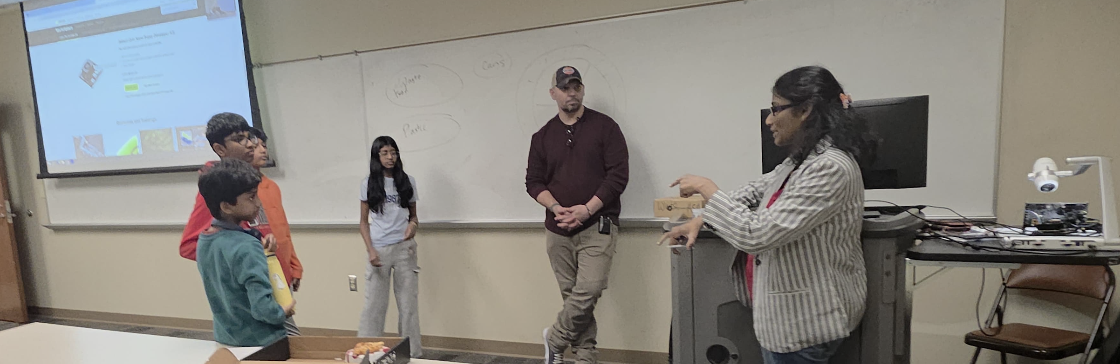
Presidential AI Challenge
Supervised By Dr. Vijayalakshmi Saravanan*
Middle School Students: Yatra Mathiarasu¹, Harshith Rajesh², Harjuna Balasakthikumar³,and Shara Shree Jagannathan⁴
University of Texas at Tyler*, Uplift Northhills Preparatory School¹, Irving TX, GreatHearts, Public Charter School²,
Irving TX, Downing Middle School³, Flower Mound, TX, Boulan Park Middle School⁴, Troy, MI
Background
Preliminary Work by Middle School Students
The poster presents a collection of student-led artificial intelligence (AI) projects developed by middle school students under faculty and mentor guidance. The projects were completed within a national AI education initiative supported by the Presidential AI Challenge, emphasizing hands-on learning, ethical AI, and real-world problem solving. Students from diverse grade levels collaborated with community teams to identify meaningful challenges in their local communities, and faculty and mentors guided them through the development of AI-based solutions.
These projects provided students with foundational knowledge and practical skills in AI while empowering educators to mentor students. The local community was involved in identifying real-world problems where AI could accelerate understanding and provide impactful solutions, fostering an inclusive ecosystem for preparing the next-generation of AI experts and solving real-world problems.
This poster summarizes the project motivation, AI methodologies, system design, and key results. In addition, it highlights student learning outcomes, technical skill development, and broader impacts achieved through this project-based learning experience.
AI-Powered Automated Attendance and Health Monitoring System
Motivation/Community Problem
In our middle school, teachers spend 5–10 minutes per class period manually taking attendance, resulting in 30–60 minutes of lost instructional time per day. Manual attendance is also prone to errors, leading to inaccurate records that directly affect school funding through average daily attendance (ADA) reporting. Post-pandemic, schools face an additional challenge of efficient health screening. Manual temperature checks create bottlenecks at entrances; delay class start times and require dedicated staff. Staffing for attendance and health monitoring can exceed $15,000 per year per school, while reducing teaching time and increasing operational costs. ClassBot was developed to address these challenges by providing an automated, accurate, and affordable system for attendance tracking and health monitoring in school environments.
ClassBot
ClassBot (Your Smart Classroom Companion) implements professional-grade computer vision and multimodal identification technologies.
Edge AI platform: Built on an NVIDIA Jetson Nano edge device, enabling real-time, low-power AI inference suitable for continuous classroom deployment.
Multimodal identification: Combines facial recognition and RFID verification to ensure accurate identification while supporting privacy preferences and full student coverage.
Computer vision pipeline: Uses deep-learning–based face detection and recognition to automatically identify students as they enter the classroom, even under varying lighting and viewing angles.
Non-contact health screening: Integrates an infrared temperature sensor with depth calibration to perform accurate, contact-free fever screening during entry.
Real-time attendance logging: Automatically records attendance with timestamps and identification confidence and exports data directly to the school information system.
Privacy-aware design: Stores only mathematical face embeddings and anonymous IDs; no images are saved, ensuring FERPA-compliant, on-device data handling.
Human-in-the-loop operation: Provides voice and touchscreen feedback with teacher override capability to ensure reliability and safe deployment in classrooms.
Datasets, Challenges, and Solutions
Real classroom data: Student face embeddings, RFID identifiers, attendance timestamps, and temperature readings were collected and stored locally using anonymized IDs, with no raw images saved to protect privacy.
Lighting and pose variability: Classroom environments include different lighting conditions and face angles, which can reduce recognition accuracy. This was addressed using depth-aware cameras and face alignment to normalize images before recognition.
Identification reliability: Facial recognition confidence may vary across students and conditions. A multimodal fallback system (AI + RFID) ensures 100% identification coverage while respecting student opt-out preferences.
Distance-sensitive temperature sensing: Non-contact temperature measurements can be inaccurate if distance varies. Depth calibration was used to enforce optimal sensing range and reduce false readings.
Privacy and compliance: To meet FERPA requirements, the system stores only numerical embeddings and IDs, never raw face images, and performs all processing locally on the device.
Real-time performance constraints: Continuous classroom operation required efficient inference. GPU acceleration and model optimization enabled real-time processing at 20–25 FPS on low-power hardware.
Results and Impact
High identification accuracy: Facial recognition achieved 96.8% accuracy (242 out of 250 identifications), and the multimodal system (AI + RFID) reached 100% identification accuracy with zero missed students.
Fast real-time processing: Average processing time was 1.2 seconds per student, allowing 25 students to be processed in ~30 seconds, compared to 5–10 minutes using manual attendance.
Reliable fallback performance: RFID verification was required in only 3.2% of cases, ensuring full coverage while maintaining robustness and student choice.
Accurate health screening: The non-contact temperature sensor achieved ±0.3 °C accuracy compared with a reference thermometer, enabling reliable fever detection.
Major cost reduction: Annual operating costs were reduced from $28,800 (manual system) to approximately $300 per year, achieving 99% cost savings.
Improved school operations: Automated attendance logging and nurse alerts eliminated attendance errors, reduced administrative workload, and improved classroom efficiency.
Novelty of ClassBot
Multimodal redundancy for reliable identification: Combines facial recognition with RFID verification to ensure complete identification coverage while allowing students to select a privacy-preferred method when needed.
Edge AI with GPU acceleration: Executes advanced facial recognition models on-device using GPU-accelerated inference, achieving near real-time performance without cloud processing, reducing latency and preserving data privacy.
Dual-purpose classroom system: Integrates automated attendance and depth-calibrated health screening into a single platform, simultaneously improving instructional efficiency and post-pandemic safety.
Dramatic cost efficiency: Delivers high-accuracy automation at approximately $300 per year, representing a 99% cost reduction compared to traditional manual systems while freeing staff for educational activities.
Conclusion
ClassBot demonstrates how accessible artificial intelligence can meaningfully improve everyday school operations while promoting safe and efficient learning environments. Through this project, students not only explored how AI, sensors, and edge computing can automate attendance and health monitoring, but also gained valuable understanding of responsible technology use, system design, and ethical considerations. Beyond its technical achievements, ClassBot highlights the power of project-based learning to prepare students with the skills, confidence, and curiosity needed to become future innovators in AI and engineering.
System Architecture
Our Team
Students
Middle school students contributed to problem identification, system design discussions, data understanding, testing, and result interpretation.
Actively participated in evaluating system accuracy, reliability, and usability, and learned to connect technical outcomes with real classroom needs and school operations.
Supervisor (Dr. Vijayalakshmi Saravanan)
Dr. Vijayalakshmi Saravanan taught about AI and did the hard coding
HPC-AI Team Members at UT Tyler (( Dr. Tupendra Oli, Jon Ryan Cole, Sai Karthik Navuluru)
Mentors supported students by assembling hardware components, assisting with device integration, and refining project designs through feedback and suggestions.
Tools and Primary Sources
What They Learned?
Hardware platform: NVIDIA Jetson Nano (edge AI processor), Intel RealSense D435 RGB-D camera, MLX90614 infrared temperature sensor, RC522 RFID reader, touchscreen display, speaker, cooling fan, and power components (total system cost ≈ $420).
Software and libraries: Ubuntu with JetPack SDK, Python, OpenCV (CUDA-enabled), TensorFlow, PyTorch, TensorRT, librealsense SDK, SQLite database, and text-to-speech tools.
Core AI models: MTCNN for face detection and alignment; ArcFace with ResNet backbone for facial recognition and identity matching.
Health standards: CDC guidelines for non-contact temperature screening and fever thresholds.
Educational resources: NVIDIA Jetson Developer Zone, Intel RealSense documentation, OpenCV-CUDA tutorials, TensorRT optimization guides, and FERPA compliance materials.
How AI systems work in real life: Students learned how computer vision, sensors, and identification systems work together to solve practical problems in schools.
Multimodal thinking: Understood why combining multiple technologies (AI + RFID + sensors) improves reliability, accuracy, and fairness compared to using a single method.
Interpreting AI performance: Learned how to evaluate system accuracy, processing speed, and error rates, and why confidence thresholds and fallback methods are important in real deployments.
Responsible and ethical AI use: Gained awareness of privacy, consent, and data protection, and why storing embeddings instead of images helps protect student identities and meet school regulations.
Systems engineering concepts: Developed an understanding of how hardware, software, sensors, and databases integrate into a complete, real-time AI system.
Problem-solving and collaboration: Strengthened skills in identifying community problems, testing solutions, working with mentors, and communicating technical ideas clearly.
Hardware Setup
Cost-Effectiveness Analysis
Performance Results
Students Reflection
Yaathra: "The AI handles both attendance and health screening in one system, cutting costs while preventing virus spread effectively in schools”
Harshith: "I’m fascinated by how the AI learned to recognize and distinguish twins with microfeatures even.”
Harjuna: "Integrating hardware and AI for real-time recognition was fun to experience.”
Shara: “It was a great experience to learn AI, which helps to advance my Robotics class as well.”
“ClassBot: Affordable AI Companion for Every Classroom”

